Slide 1
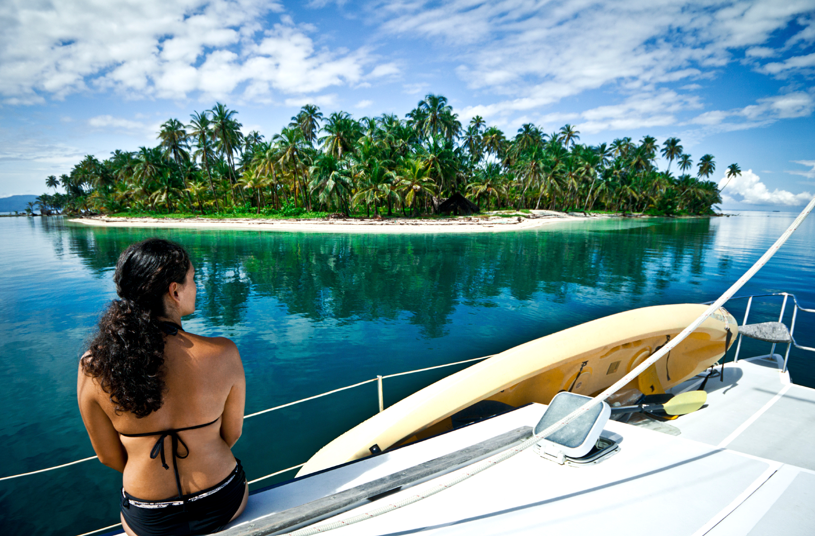




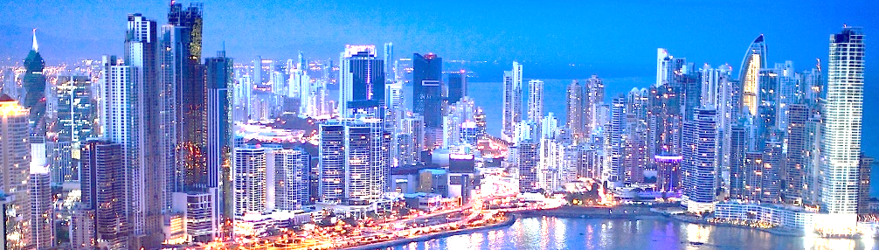
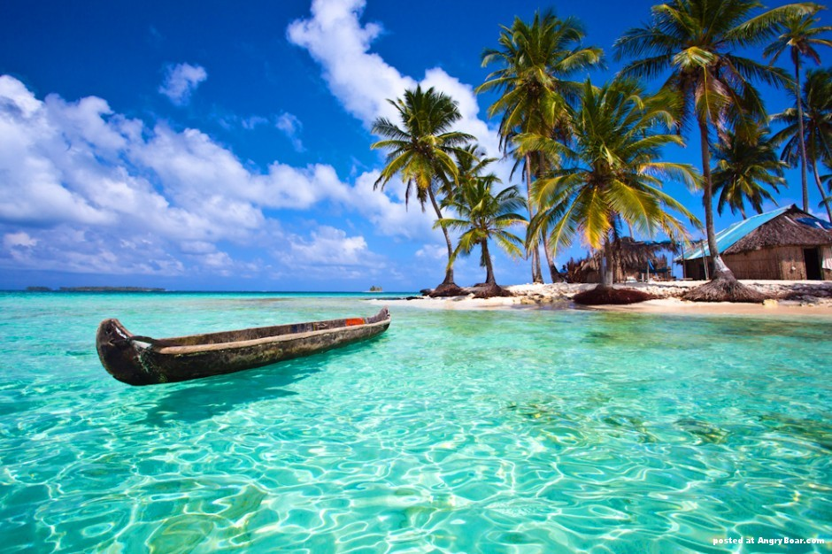



HOME
ABOUT
TOURS
EVENTS
GALLERY
CONTACT
The destination of your dreams is just one click away
Travel
Enjoy
Discover
CITY TOURS
Discover the landmarks of Panama and learn about its culture and people
Read more
BEACH TOURS
Relax in a Caribbean island and swim in one of the beaches with the clearest waters in the world
Read more
Rights Reserved © 2017

